Slide 1
The impact of the Football Governance Act on dispute resolution in football
  November 2025

Slide 2
Football governance: where are we now?
Shane Sibbel and Celia Rooney
November 2025

Slide 3

Source of Powers: creatures of contract…
The FA and PL are both private limited companies, and creatures of contract – not statute
Principles of contractual interpretation
Public law overlay – supervisory jurisdiction and unilateral powers
Bradley v Jockey Club
Braganza v BP Shipping

Slide 4
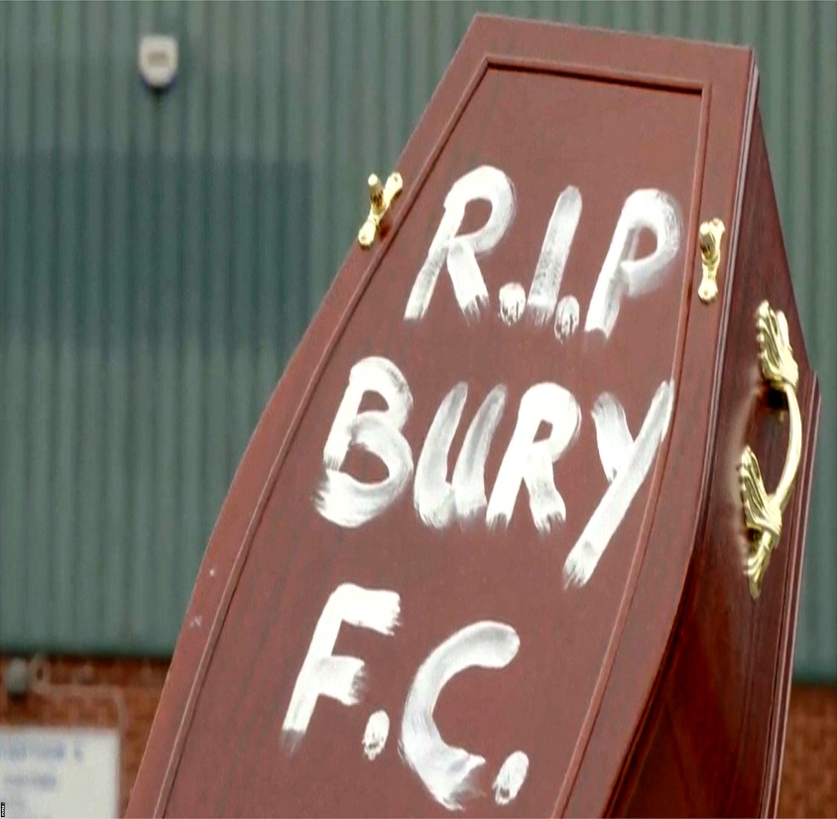
Scope of powers
Not just the laws of the game…
Extensive financial regulation – e.g. the PL Profitability and Sustainability Rules
Owners and Directors Test – FA, PL and EFL

Slide 5
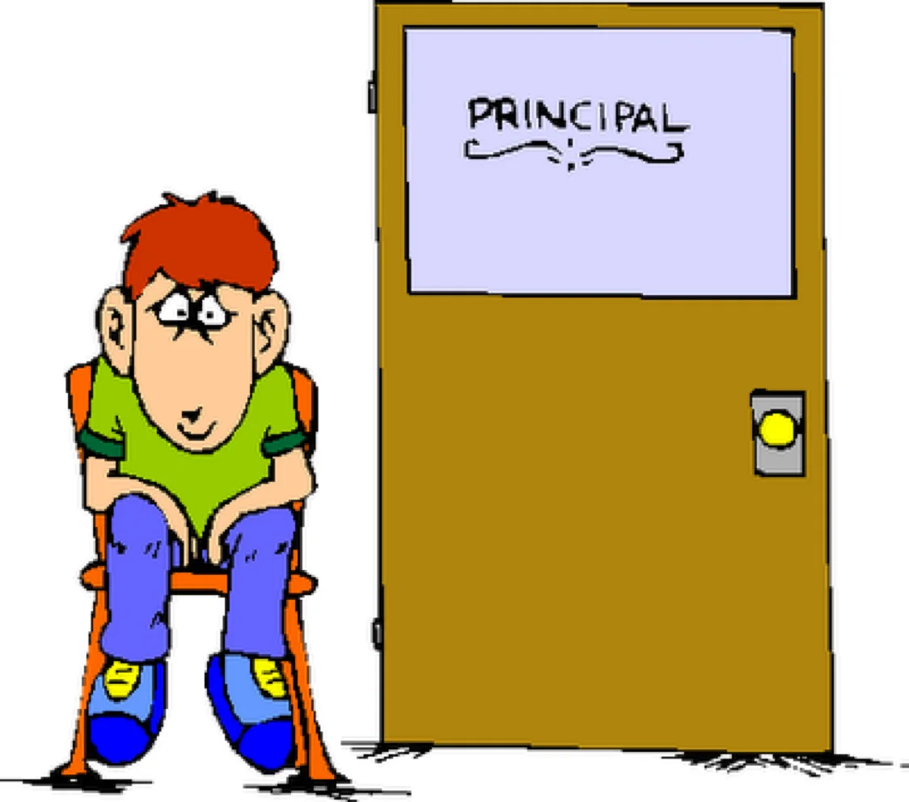
Investigations for Misconduct
Powers of inquiry – obtaining documents
Powers of inquiry – interviewing witnesses
Failure to cooperate?

Slide 6

Proceedings and sanction
Nature of the proceedings – arbitral? ECB v Kaneria
Arbitrability issues – Fulham Football v FAPL
Principles of sanction – proportionality, equal treatment, lex mitior and double jeopardy

Slide 7
Football Governance Act 2025
James Segan KC and Marlena Valles
  November 2025

Slide 8
Statutory Purpose of the Football Governance Act 2025
"The purpose of this Act is to protect and promote the sustainability of English football"
s.1(1)
"For the purposes of this section, English football is sustainable if it:
(a) continues to serve the interests of fans of regulated clubs, and
(b) continues to contribute to the economic or social well-being of the local communities with which regulated clubs are associated."
s.1(3)

Slide 9
The Independent Football Regulator
"A body corporate called the Independent Football Regulator is established"
s.5(1)
The IFR has three "objectives" (s.6)
1. To protect and promote the "financial soundness" of regulated clubs.
2. To protect and promote the "financial resilience" of English football.
3. To "safeguard the heritage" of English football.

Slide 10
The Independent Football Regulator
The IFR has a series of "general duties" (s.7):
1. To act compatibly with the purpose of the Act.
2. To advance one or more of its objectives (see previous slide).
3. To have regard to avoiding (a) effects on sporting competitiveness of a club, or (b) adverse effects on “the financial growth of, or financial investment in, English football” .

Slide 11
The Independent Football Regulator
The IFR has a series of "regulatory principles" to which it must have regard (s.7(3)(a), 8), including:
1. Engagement with interested parties including fans.
2. Proportionality, consistency, transparency.
3. The existing “rules, requirements and restrictions imposed by competition organisers”.
The IFR must also have regard to (i) a "state of the game" report which it must prepare (s.10), (ii) any policy statement of the Secretary of State (s.11), (iii) the IFR's guidance (s.12), (iv) any guidance of the Secretary of State (s.13).

Slide 12
Club Licensing
  A club may not operate a team unless it holds a provisional or a full operating licence (s.15)
  The "full licence test" is (i) compliance with Schedule 4 conditions, (ii) compliance with mandatory licence conditions and club duties, and (iii) compliance of owners and officers with suitability (s.18(3)).
  The IFR must attach certain mandatory conditions, whereby the club must provide financial plans, a corporate governance statement, regular fan consultations, and an annual declaration (s.20, Sch. 5)
  The IFR may also attach discretionary conditions (debt management, liquidity, overall expenditure, ability to accept funding related to criminal conduct, internal controls, risk management and financial reporting) (ss.21-22).

Slide 13
Suitability
Must notify IFR where a “reasonable prospect” of ownership (s.27).
Suitability application must cover proposed operation of club, costs, funding and sources of funding (s.28(2)).
Suitability = honesty, integrity, financial soundness, competence (officers only) (s.26(7)-(8)):
  Honesty and integrity not just criminality but other legal regulatory and disciplinary actions (s.37(2)).
  Financial soundness includes past bankruptcies, financial situation of past companies (s.37(3)).
Directors must be assessed as suitable also (s.29).
Duty to notify material change of circumstances (s.33).
Owners and directors can ultimately be removed (ss.39-40, 43).

Slide 14
Duties on clubs
Duty not to participate in a “prohibited competition”, which means one prohibited by the IFR having regard to whether it is “merit-based”, based on “open and fair competition”, sustainability and “heritage” (s.45).
Duty not to dispose of home ground without approval (s.46).
Duty not to relocate, change club colours, crest or name without approval (s.49).
Duty to notify change of circumstances (s.50).
Duty to pay levy (s.52).

Slide 15
Duties on competition organisers
Duty to notify IFR when it “considers or suspects” a club has breached a competition rule which is “relevant to the exercise of any of the IFR’s functions” (s.55(1)(c), (8)).
Duty to consult the IFR when varying such a competition rule (s.55(6)).

Slide 16
The Heritage Objective
Fan consultation
  Fans must generally be consulted (Sch 5(8))
  Fans must be kept informed of insolvency proceedings (s.51)
Stadium relocations
  There is a duty not to re-locate without approval (s.48)
Club identification
  There is a duty not to change the club crest, home shirt colours or name without approval (s.49)

Slide 17
The IFR's Investigation Powers
"The IFR may conduct an investigation where it has reasonable grounds for suspecting that a person has committed a relevant infringement." - s.68(1)
The term "relevant infringement" is defined in Schedule 7, and includes breach of licence conditions, failure to comply with requirements imposed, or directions given.
If there is a relevant infringement, the IFR has:
The power to ask questions (Sch 8(2))
The power to enter a business with a warrant (Sch 8(3))

Slide 18
Enforcement Powers
The IFR may issue a warning notice (s.76) and then a decision notice (s.77)
Sanctions can include:
    A revocation of operating licence (s.19) - but the threshold is high
    A disqualification (s.38)
    A determination that a person is not suitable to be the owner or officer of a club (ss.34, 35)
    A fine equal to 10% of the total revenue of the club or organiser (Sch 9(6))
    Issuing of a censure statement (Sch 9(2))

Slide 19
Review
"Where the IFR makes a reviewable decision, a concerned person may request a review of that decision by the applicable reviewer." - s.82(1)
Reviewable decisions are set out in a table at Schedule 10, and the decision may be reviewed by either a committee of the Expert Panel or the Board.
The applicable reviewer can decide to uphold, vary, or cancel the decision (s.83(2)).

Slide 20
Direct Appeal to the CAT
Certain reviewable decisions can be appealed directly to the CAT, at s.84(3):
Revocation of an operating licence
Deemed determination of suitability to be an owner or officer of a club
Making of an order for disqualification of a person
Suspending or revoking an operating licence
The CAT can determine the appeal on its merits (s.85(1))

Slide 21
Appeal to the CAT after Review
For decisions set out at s.84(3) (previous slide) which have gone to the internal reviewer, the internal reviewer's decision can be reviewed by the CAT (s.84(1)(b))
All other reviewable decisions which have first been internally reviewed can also be reviewed by the CAT (s.84(1)(b))
In both cases, the appeal to the CAT is a review of the decision of the internal review.
"The Tribunal must determine any other appeal under section 84(1) by applying the same principles as would be applied by the High Court in determining proceedings on judicial review." - s.85(2)

Slide 22
Wider perspectives on the new regulatory regime
Tom Hickman KC
  November 2025

Slide 23
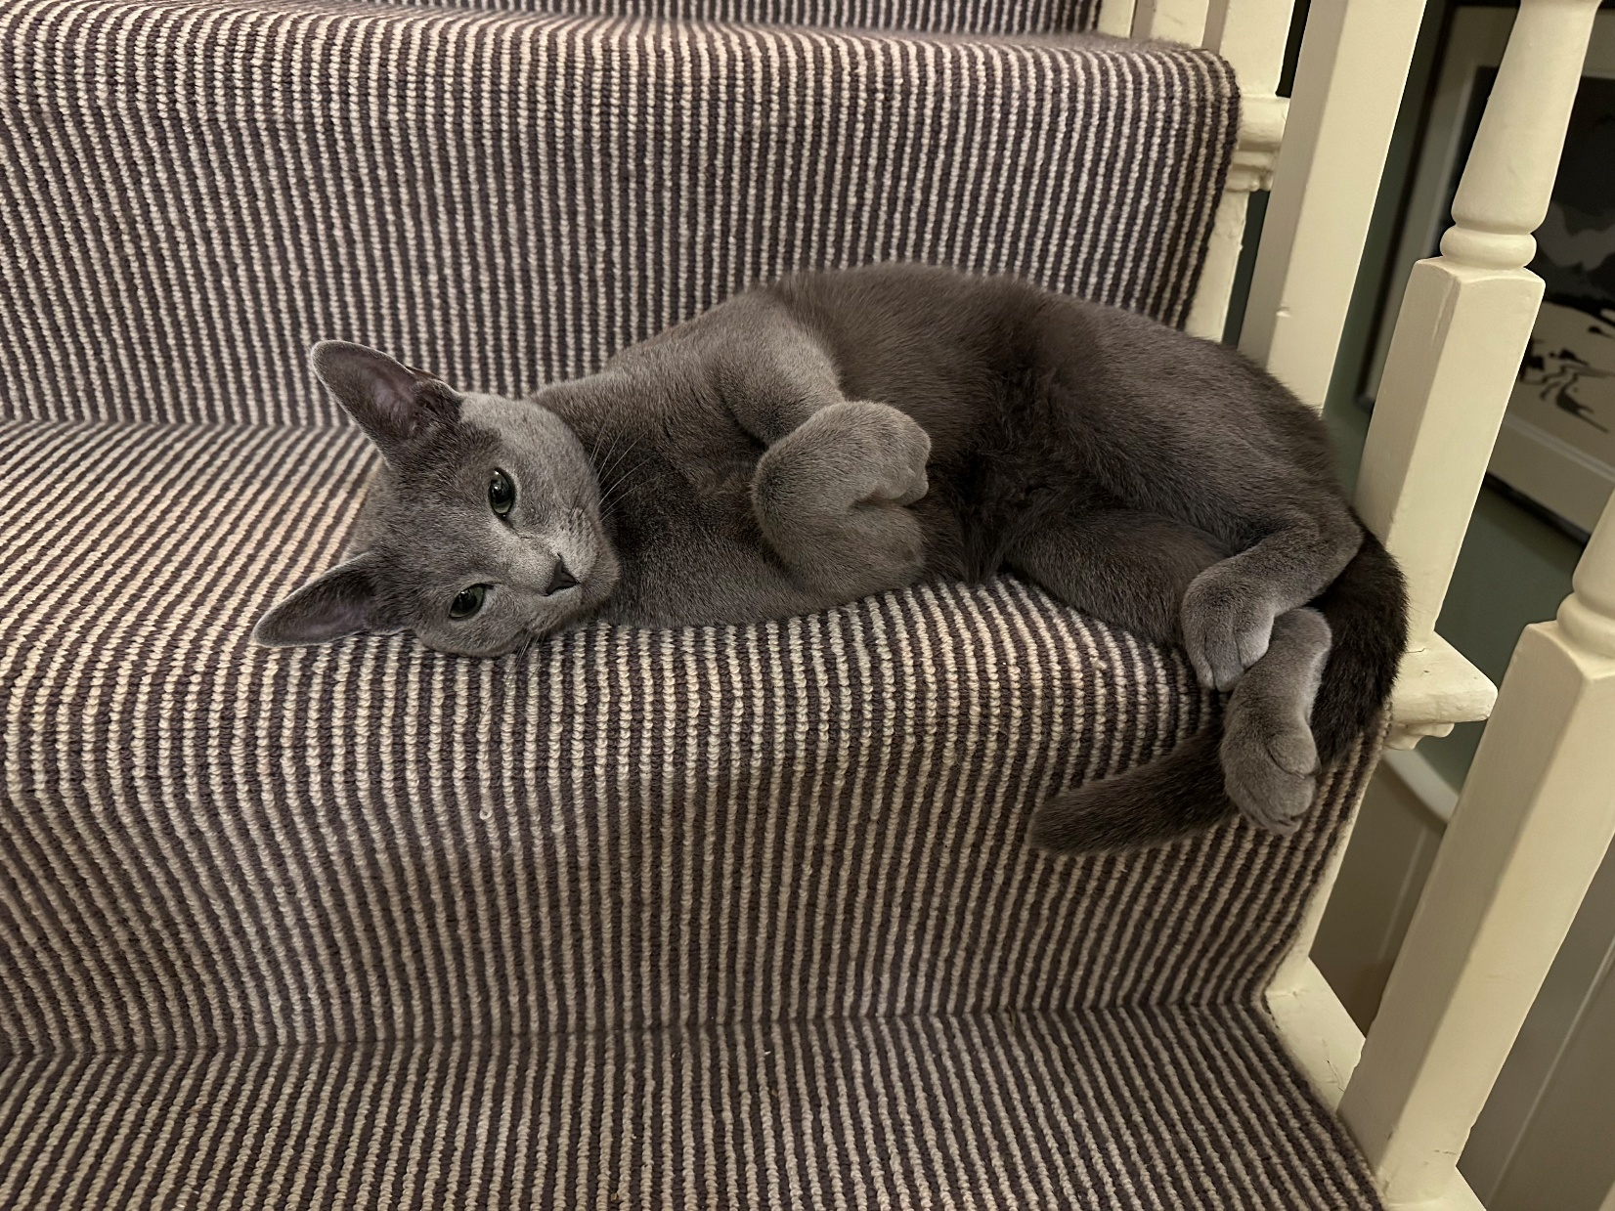

Football Governance Act 2025: impact of the right of appeal
Tom Richards KC
  November 2025

Slide 24
‘A concerned person, or any other person with a sufficient interest, may appeal to the Tribunal against a decision to which this section applies’
Football Governance Act, section 84(2)

Slide 25
“Sufficient interest”: statutory inspiration
Section 47(2) of the Competition Act 1998:
‘A person may make an appeal under subsection (1) only if the Tribunal considers that he has a sufficient interest in the decision with respect to which the appeal is made, or that he represents persons who have such an interest.’
Section 31(3) of the Senior Courts Act 1981:
‘No application for judicial review shall be made unless the leave of the High Court has been obtained in accordance with rules of court; and the court shall not grant leave to make such an application unless it considers that the applicant has a sufficient interest in the matter to which the application relates.’

Slide 26
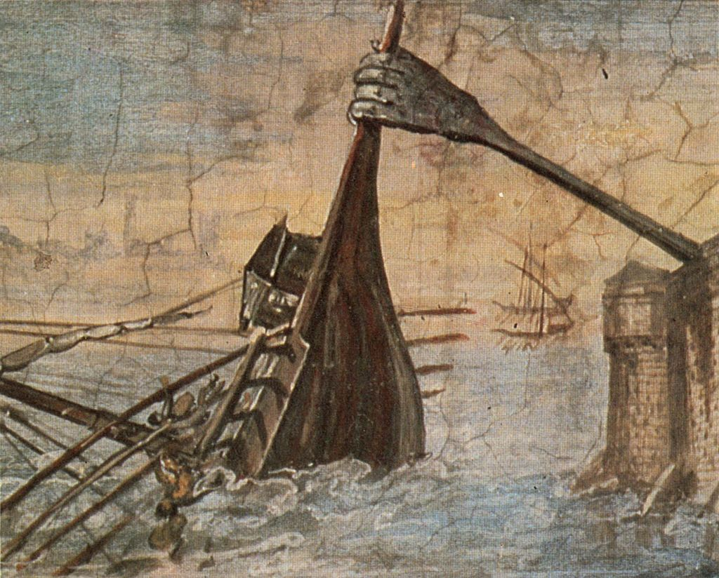

Slide 27
“Sufficient interest” in judicial review...
Inland Revenue Commissioners v National Federation of Self-Employed and Small Businesses Ltd [1982] AC 617
R (Good Law Project) v Prime Minister [2022] EWHC 298 (Admin)
in football arbitration…
Sheffield United Football Club Ltd v Football Association Premier League Ltd [2007] ISLR-SLR 7
and under the 2025 Act?

Slide 28
CAT appeals vs. arbitration
CAT
Open justice
CAT chair + wing members
Publicly available jurisprudence
Founded in statute
Arbitration
Privacy
Choice of arbitrator(s)
Restricted availability of prior decisions
Founded in consent

Slide 29
Telephone: +44(0) 207 583 1770
Email: clerks@blackstonechambers.com
www.blackstonechambers.com

